Slide 1
INSOLVENCY AND BANKRUPTCY
Project-373:
Team Members:
1.Miss. Shivani Pawar
2. Mr. Tulasi Mohan Kandimalla.
3. Mr. Venugopal G
4. Mr. G karthikeya
5. Miss.Jaya lakshmi Vuyyuru
6. Mr.Mohd Arhaan Ahmad

Slide 2
Index:
Problem statement
Objective
Insolvency
Reasons for Insolvency
Bankruptcy
Types of Bankruptcy
Insolvency vs Bankruptcy
EDA
Feature Engineering
Model Building
Model Validation
Deployment

Slide 3
PROBLEM STATEMENT:
The problem statement is to check the whether it is a bankruptcy or solvent.

Slide 4
Objective:
Consolidate and amend all existing insolvency laws in India
To simplify the Insolvency and Bankruptcy Proceedings in India.
To protect the interest of creditors including stakeholders in a company.
To revive the company in a time-bound manner
To promote entrepreneurship and consequently increase the credit supply in the economy.
To work out a new and timely recovery procedure to be adopted by the banks,financial institutions or individuals.
Maximization of the values of assets of corporate persons.

Slide 5
Insolvency
Insolvency is a state where the liabilities of an individual or an organization exceeds its asset and that entity is unable to raise enough cash to meet its obligations or debts as they become due for payment.
The main reasons behind insolvency are primarily poor management and financial constraints.

Slide 6
Reasons for Insolvency
Reasons for Insolvency
-bad debt-obviously money owned by customers
-Management-failure to acquire adequante skills,imprudent accounting,lack of information system.
-Finance-loss of long term finance ,over gearing or lack of cash flow

Slide 7
Bankruptcy
Bankruptcy is when a person or company is legally declared incapable of paying their due and payable bills.
The individual asks for help from government to pay off his debts to his creditors.

Slide 8
Types of Bankruptcy
Bankruptcy could of two types :reorganization bankruptcy and liquidation bankruptcy.
Usually people tend to restructure the repayment plans to pay them easily under reorganization bankruptcy.
And under liquidation bankruptcy,the debtor tends to sell of certain of their assets to pay off their debts for their creditors.

Slide 9
Insolvency Vs. Bankruptcy
Insolvency is not the same as bankruptcy.Insolvency is a state of economis distress,whereas bankruptcy is a court order that decides how an insolvent debtor will deal with unpaid obligations.That usually involves selling assets to pay the creditors and erasing debts that can’t be paid.
Bankruptcy can severely damage a debtors credit rating and ability to borrow for years.
An individual or company can be insolvent without being bankrupt, especially if the insolvency is temporary and correctable.
But bankruptcy cannot be without insolvency.

Slide 10
EDA:
Evaluation of Data Analysis is a process of describing the data by means of statistical and visualization techniques in order to bring important aspects of that data into focus for further analysis.
1.Maximize insight into a data set.
2.Uncover underlying structure.
3.Extract important variables.
4.Detect outliers and anomalies.
5.Test underlying assumptions.
6.Develop parsimonious models.
7.Determine optimal factor settings.

Slide 11
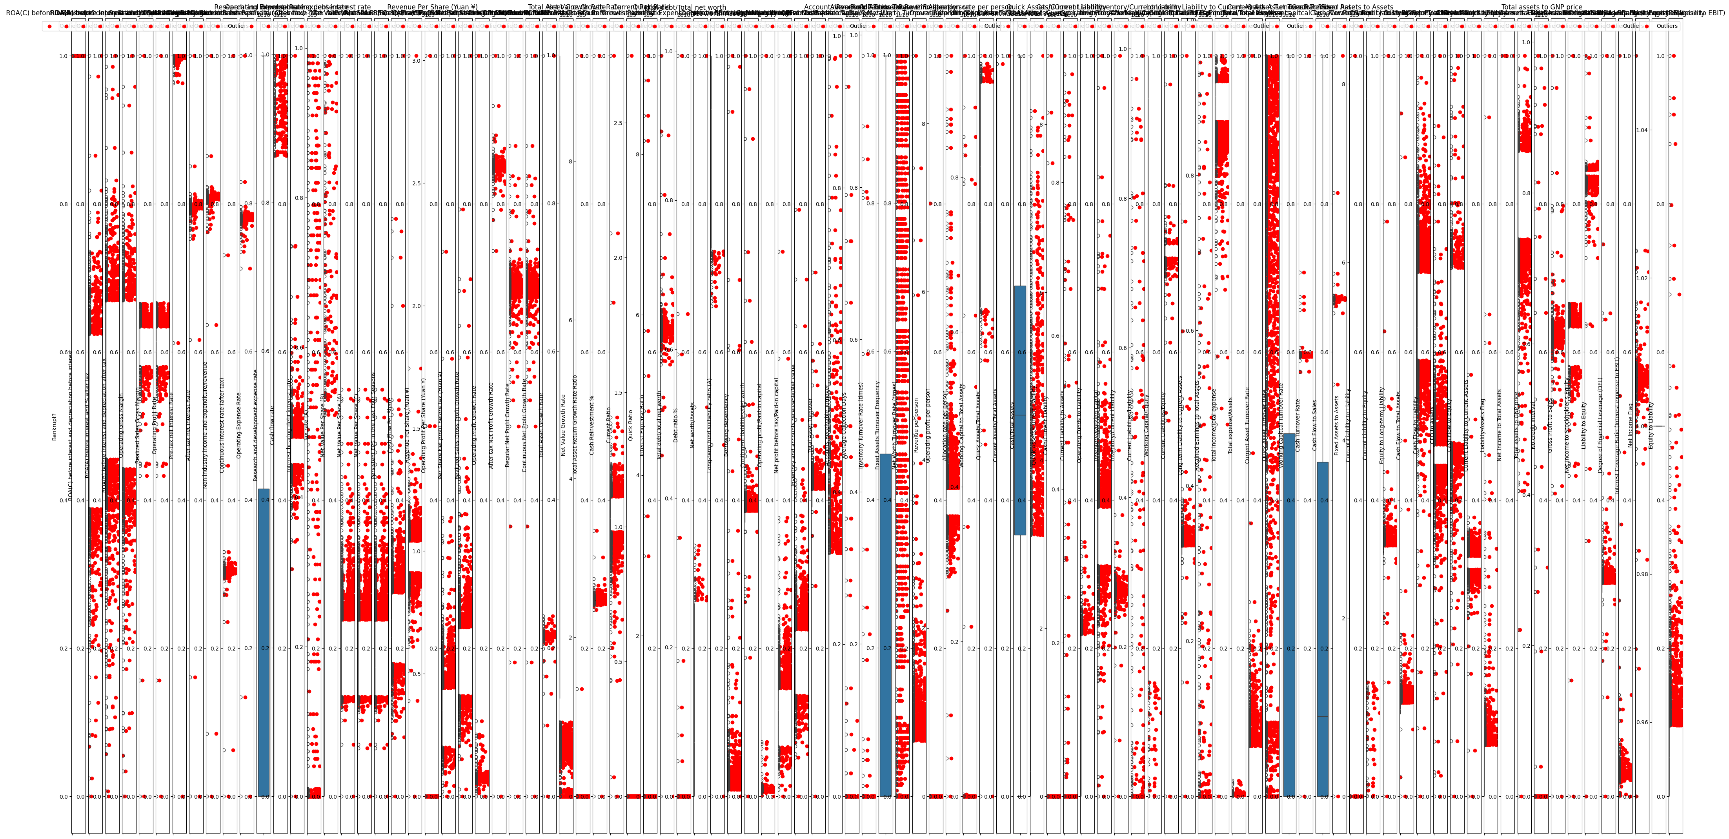
Before Removing The Outliers

Slide 12
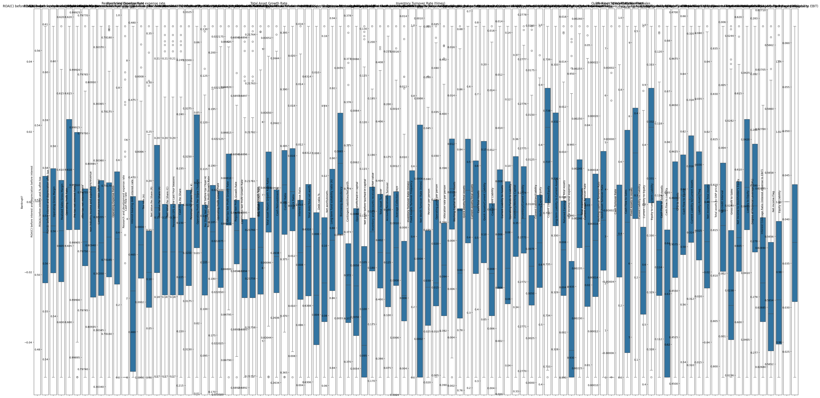
After Removing the Outliers:

Slide 13
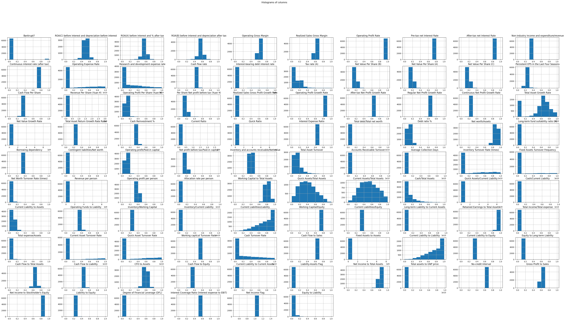
Visualizing the Data

Slide 14
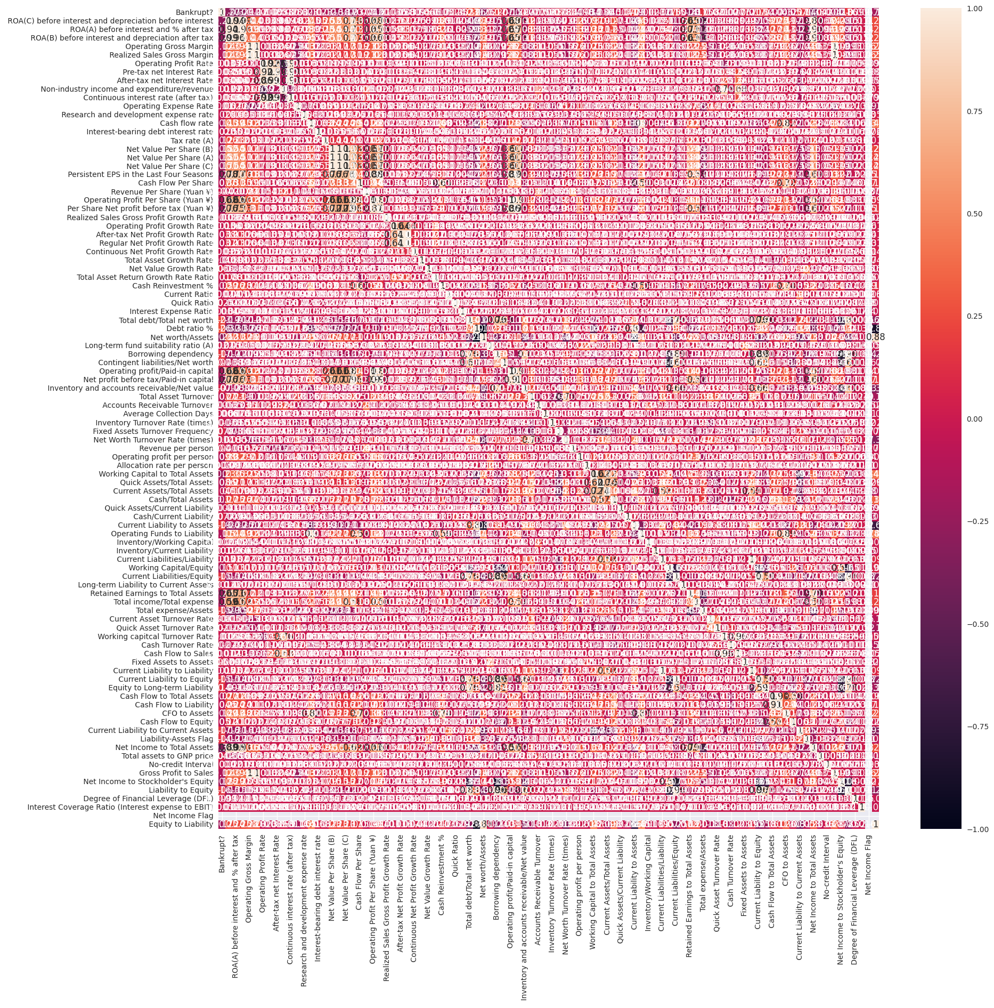
Correlation after removal of outliers

Slide 15
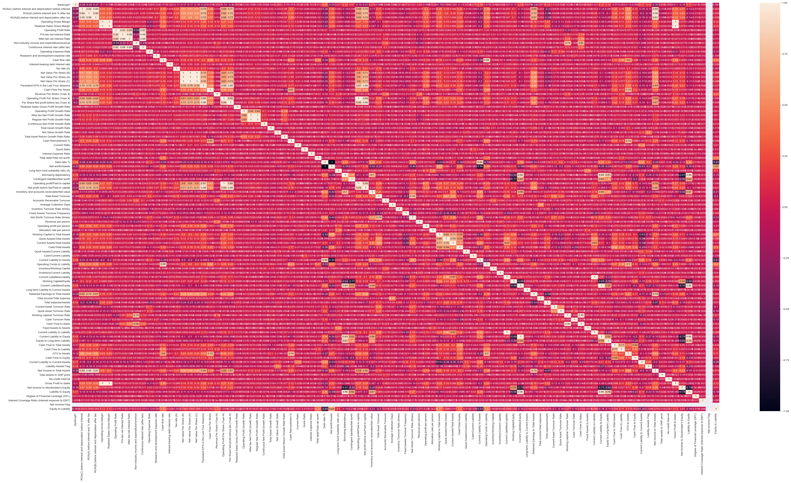
Heatmap:

Slide 16
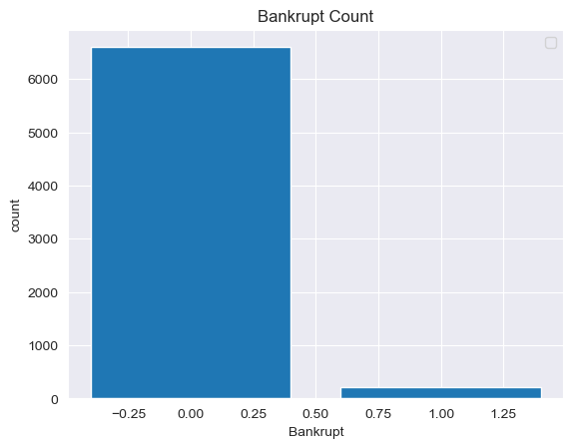
Independent Variables count

Slide 17
Feature Engineering
1.Imputation: Imputation is responsible for handling irregularities within the dataset. Example:removing the missing values from the complete column by a huge percentage of missing values.
2.Handling Outliers: Outliers are the deviated values or data points that are observed too away from other data points in such a way that they badly affect the performance of the model
3.Log transform: log transform helps in handling the skewed data,and it makes the distribution more approximate to normal after transformation.
4.Encoding: One hot encoding converts the categorical data in a form so that they can be easily understood by machine learning algorthims and make good prediction.
5.Scaling:The continuous features become identical in terms of the range,after a scaling process.

Slide 18
Model Building
Step 1: Define the Problem and Set Objectives:
Clearly define the problem you aim to solve and establish measurable objectives. Understand the scope, constraints, and desired outcomes of your model. This step ensures that your model aligns with the problem at hand and provides meaningful insights.
Step 2: Gather and Prepare the Data:
Collect the relevant data required for model building. Clean and preprocess the data, handling missing values, outliers, and inconsistencies. Perform feature engineering and selection to extract meaningful predictors and ensure data quality.
Step 3: Split the Data:
Split your data into training and testing sets. The training set is used to train the model, while the testing set serves as an unseen dataset for evaluating the model’s performance. Consider techniques like cross-validation for robust model assessment.

Slide 19
Process of Model Building
Step 4: Choose the Right Algorithm:
Select the appropriate machine learning algorithm based on your problem type (e.g., classification, regression) and data characteristics. Consider popular algorithms like linear regression, decision trees, random forests, support vector machines, or deep learning models.
Step 5: Train the Model:
Fit the selected algorithm to the training data. Adjust the model’s parameters and hyper-parameters to optimize its performance. Use techniques like grid search or Bayesian optimization to find the best parameter settings.

Slide 20
Process of Model Building
Step 6: Evaluate the Model:
Assess the model’s performance using appropriate evaluation metrics, such as accuracy, precision, recall, or mean squared error. Compare the model’s predictions with the actual values in the testing dataset. Consider additional techniques like ROC curves or confusion matrices for classification problems
Step 7: Fine-tune and Optimize:
Iteratively refine your model to enhance its performance. Experiment with different parameter settings, feature selections, or ensemble techniques to improve accuracy and generalization. Regularize the model to avoid overfitting and ensure it performs well on unseen data.

Slide 21
Process of Model Building
Step 8: Interpret the Results:
Understand and interpret the model’s output to gain insights into the underlying patterns and relationships in the data. Analyze feature importances, coefficients, or decision boundaries to explain the model’s behavior. Communicate the results effectively to stakeholders.
Step 9: Deploy and Monitor:
Deploy your model in a production environment to make predictions or support decision-making processes. Continuously monitor the model’s performance and assess its impact on business outcomes. Update the model periodically as new data becomes available.

Slide 22
Process of Model Building
Conclusion:
Model building is an iterative and dynamic process that requires a deep understanding of the problem, data, and algorithms. By following this step-by-step guide, you can navigate the complexities of model development with confidence.
hyper-parameter tuning, and interpretation techniques may vary based on your specific problem and dataset. Embrace the journey, experiment with different approaches, and strive to build models that deliver accurate predictions and valuable insights.

Slide 23
Model Validation:
Logistic Regression:
Cross-Validation scores: [0.96215139 0.9670987 0.96311067 0.9670987 0.96410768]
Mean CV Accuracy 0.964713429432817
KNN:
Cross-Validation scores: [0.96812749 0.96809571 0.95912263 0.9670987 0.96610169]
Mean CV Accuracy 0.9657092467617069
SVM:
Cross-Validation scores: [0.96314741 0.96510469 0.96311067 0.96510469 0.9670987 ]
Mean CV Accuracy 0.964713230825452

Slide 24
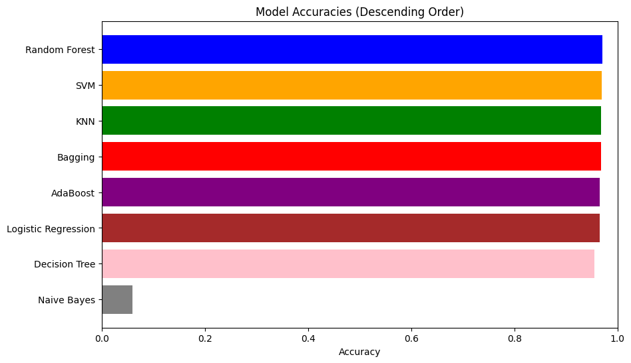
Model Accuracies in Descending Order

Slide 25
Model Validation
Random Forest:
Cross-Validation scores: [0.96713147 0.96809571 0.96311067 0.97308076 0.97208375]
Mean CV Accuracy 0.9687004722883144
Decision Tree:
Cross-Validation scores: [0.94123506 0.94915254 0.95014955 0.94516451 0.94616152]
Mean CV Accuracy 0.9463726350827993
Bagging:
Cross-Validation scores: [0.96613546 0.96510469 0.95812562 0.97308076 0.96909272]
Mean CV Accuracy 0.9663078493602857
Boosting:
Cross-Validation scores: [0.96414343 0.96410768 0.9551346 0.97208375 0.96610169]
Mean CV Accuracy 0.9643142286288544

Slide 26
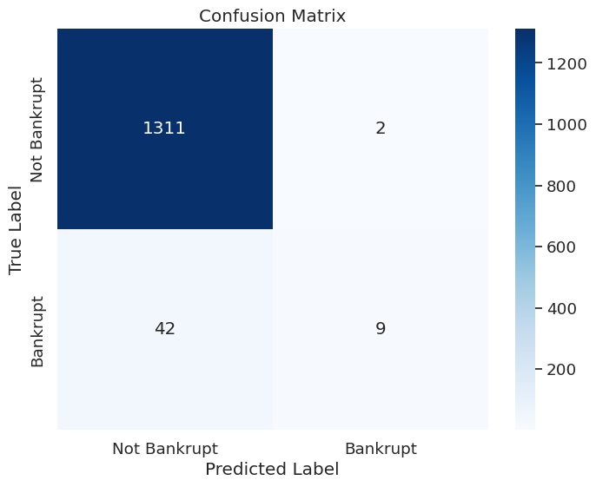
Confusion Matrix

Slide 27
Conclusion for Model Validation
Random Forest model is giving Highest average
(Mean cv accuracy: 0.9683020659138123 ~ 0.97)

Slide 28
Deployment:
Deploying the model in a production environment to make predictions or support decision-making processes. Continuously monitor the model’s performance and assess its impact on business outcomes. Update the model periodically as new data becomes available.
Deployment: Software deployment is the process of making software available to be used on a system by users and other programs. You might deploy software to create a backup copy of the software, to move the software to another system, or to create another SMP/E-serviceable copy for installing service or other products.
Streamlit is a free and open-source framework to rapidly build and share beautiful machine learning and data science web apps. It is a Python-based library specifically designed for machine learning engineers. Streamlit is easy to use, requires minimal setup

Slide 29
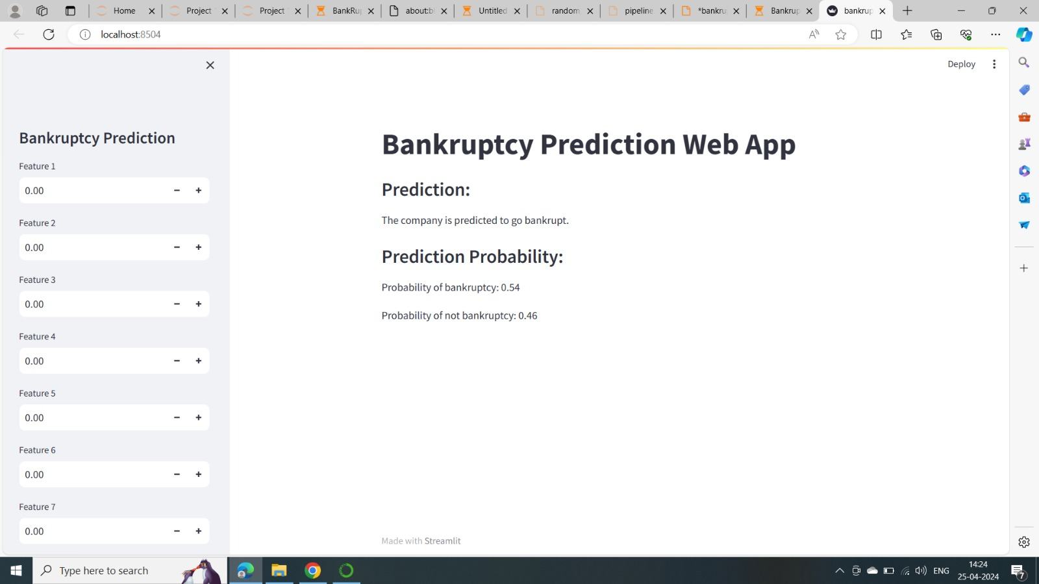

Slide 30
Challenges Faced?
We faced the challenges regarding to set up the pipeline for the deployment.
We faced the challenges to determine the best accuracy for the model building.
We faced the challenges to visualize the model building to represent the box plot and Histogram
How did you overcome?
We used the Streamlit platform to deploy the code and used the data from the given dataset to get the predicted output.
We resolved the accuracy of the model with the help of training and testing dataset by using the 7 different algoritms .
We used the outliers concept to resolve the boxplot visualisation

Slide 31


